Slide 1
LIVING AND NON LIVING
Chapter 7

Slide 2
Common feature
Both are made of matter – has mass, volume and occupies space
Both are made of structural units
Non living thing – structural unit Atoms
Living thing - structural unit Cells (viewed only through the microscope)

Slide 3
Differences between living and non living thing
GROWTH
MOVEMENT
FOOD INTAKE
EXCRETION
RESPIRATION
RESPONSE TO STIMULI

Slide 4
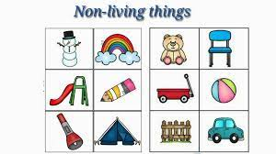
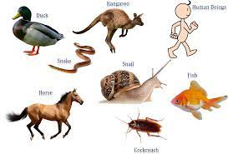
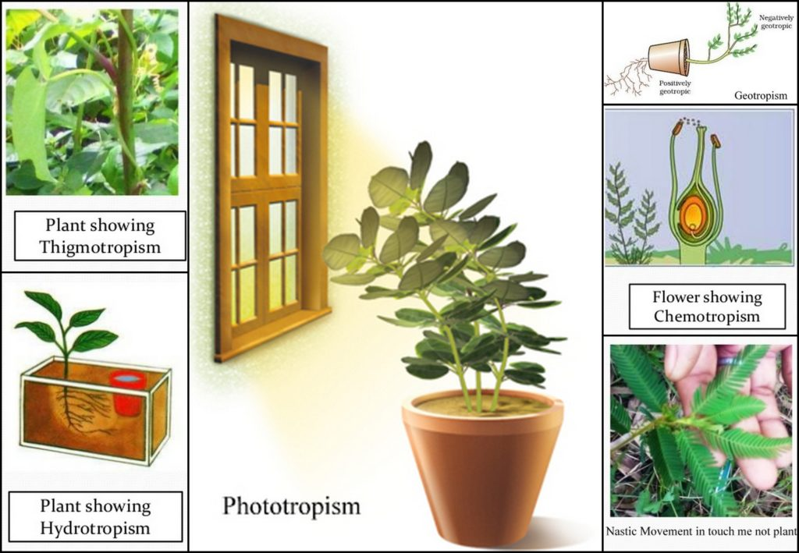
Characters of Living thing
Movement

Slide 5
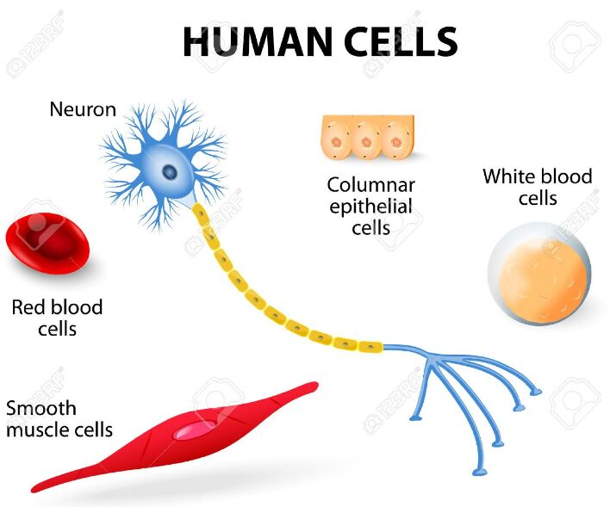
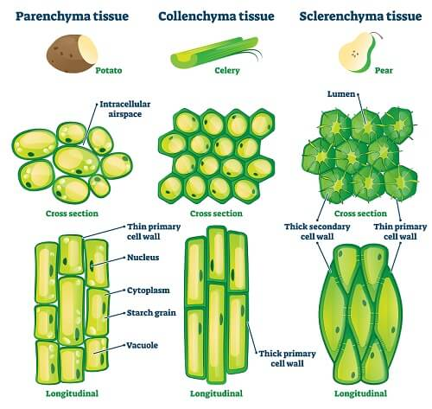
All living thing are made up of CELLS

Slide 6
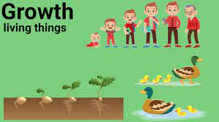
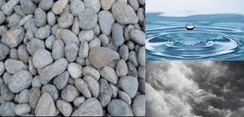
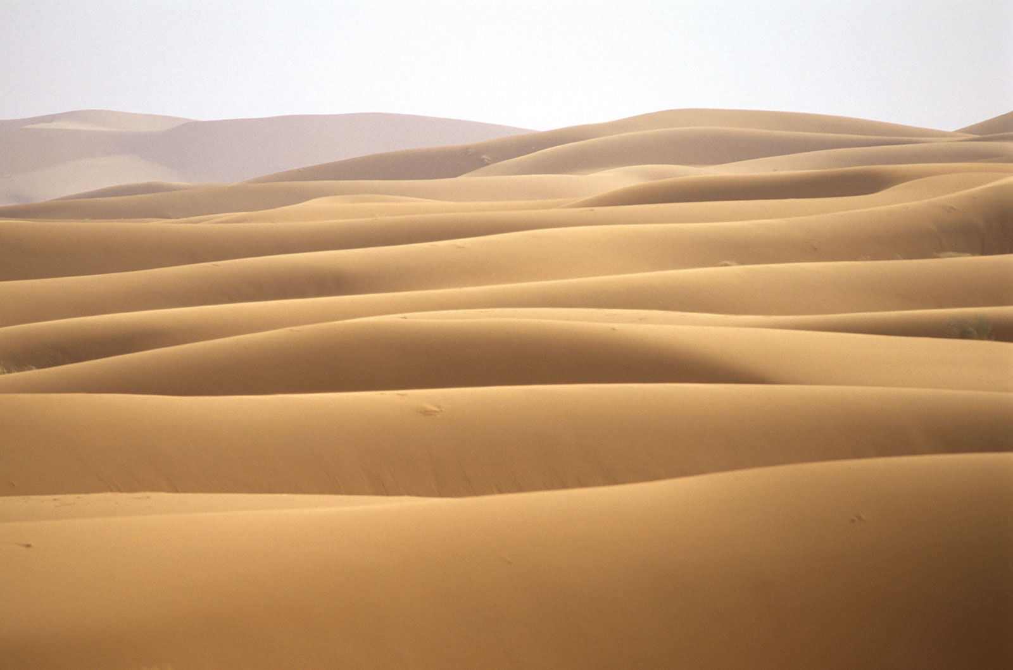
Growth of Living and Non-living things
https://youtu.be/za5z6WRz29I

Slide 7
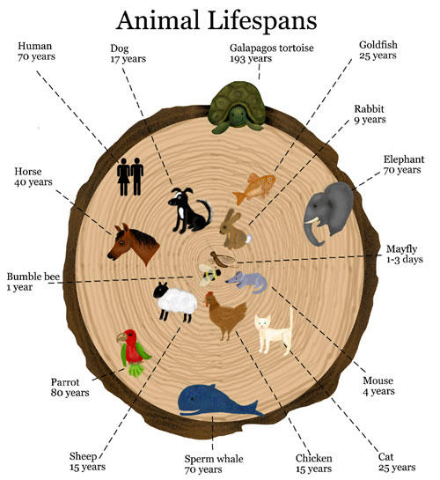
Living thing – definite lifespan
Living thing are born – grow - die

Slide 8
Question time…
1 . Name a plant that show response to stimulus.
2. Plants exchange the gases through a opening called…
3. What is phototropism and geotropism?
4. Basic unit of living thing and non-living thing..

